Slide 1
TOPIC :
TRAFFIC LIGHT
CONTROLLER
Using Verilog
BY : Dhananjay Singh

Slide 2
CONTENTS
INTODUCTION
TRAFFIC LIGHT
HISTORY
VERILOG
TRAFFIC LIGHT CONTROLLER
OUR TRAFFIC LIGHT
STATE DIAGRAM
STATE TABLE
VERILOG CODE
SIMULATION RESULT
CONCLUSION

Slide 3
INTRODUCTION
HISTORY
The first traffic light was installed in London in 1868, but it was manually operated. The modern electric traffic light, with red and green signals, was invented by Garrett Morgan in 1923. It gradually evolved with standardized colors and automated systems, becoming a crucial element for regulating traffic worldwide.

Slide 4
WHAT IS TRAFFIC LIGHT
A traffic light is a colored signal at intersections on roads. It tells drivers and pedestrians when to stop and when to go. The three colors are red, yellow, and green. Red means stop, yellow means prepare to stop, and green means go. Traffic lights help control the flow of traffic, preventing accidents and making sure everyone moves safely.

Slide 5

RED :
YELLOW:
GREEN:
Prohibits any traffic from proceeding.
Provides warning that the warning signal is changing from green to red.
Allows Traffic to proceed in the direction denoted.

Slide 6
Purpose of traffic light
TRAFFIC CONTROL :
SAFETY :
EFFICIENCY :
The primary purpose of traffic light is to regulate the flow of vehicles and pedestrians at road intersection.
Traffic light enhance road safety by providing clear signals to drivers and pedestrians , reducing the risk of collisions and ensuring orderly movement at intersections.
By assigning right of way to different directions at specific ,traffic light help optimize traffic flow ,minimizing congestion and improving overall transportation efficiency.

Slide 7
ABOUT VERILOG
Verilog is a Hardware Description Language (HDL) used for describing the behavior of electronic systems and designing digital circuits.
Verilog is used in both simulation and synthesis stages of the design process. Simulation helps validate the functionality of the design, while synthesis converts the Verilog code into a netlist for implementation on hardware.
IEEE Standard version 1800 in 2009.

Slide 8
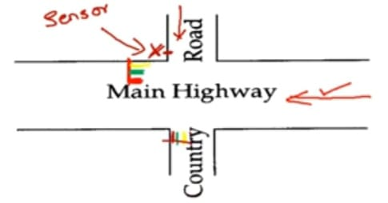
OUR TRAFFIC LIGHT SPECIFICATION
The traffic signal for the main highway gets highest priority because cars are continuously present on the main highway . Thus, the main highway signal remains green by default. Occasionally , cars from the country road arrive at traffic signal . The traffic signal for the country road must turn green only long enough to let the cars on the country road to go .

Slide 9
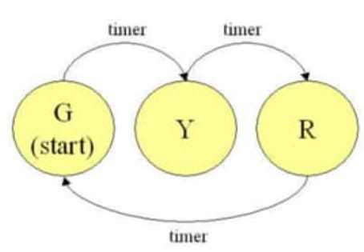
There is a sensor to detect cars waiting on the country road the sensor send a signal X as input to the controller . X=1 if there are cars on the country road ; otherwise X=0 (no car).
00 RED (R)
01 YELLOW (Y)
10 GREEN (G)
It is often useful to be able to sequence through an arbitrary number of states , staying each state an arbitrary amount of time .

Slide 10
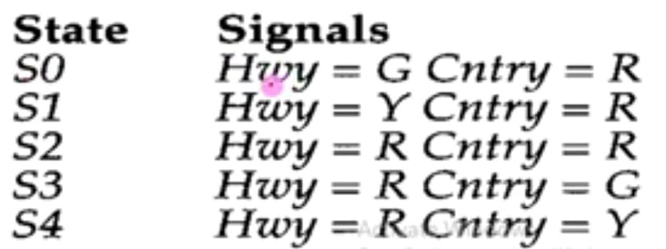
STATE TABLE
To simulate this traffic lights we will use the red ,yellow and green LEDs which cycle through the five states as shown in fig.
These five states are S0, S1, S2, S3 and S4 in which S0 is default state it means the highway LED is always green and country side is always red.

Slide 11
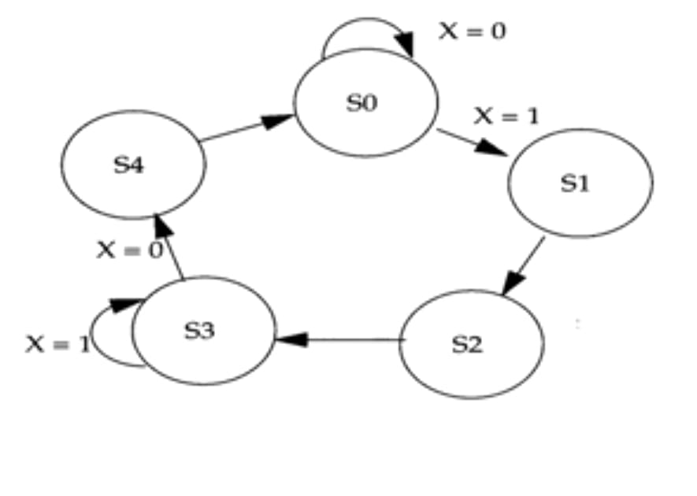
STATE DIAGRAM
State diagram for controlling this traffic light as shown in fig.
If sensor detect cars in country side then value of X become 1 and the state change from S0 to S1 and the state remains same at state S3.
If sensor not detect car in country side then X becomes 0 and sate change from S3 to S4 and S0 remains same state .

Slide 12
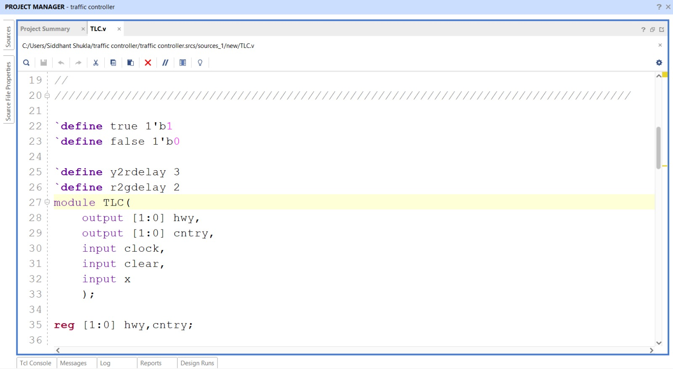
VERILOG CODE

Slide 13
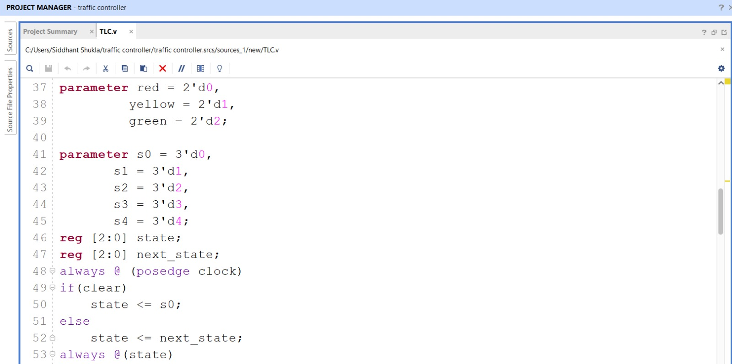

Slide 14
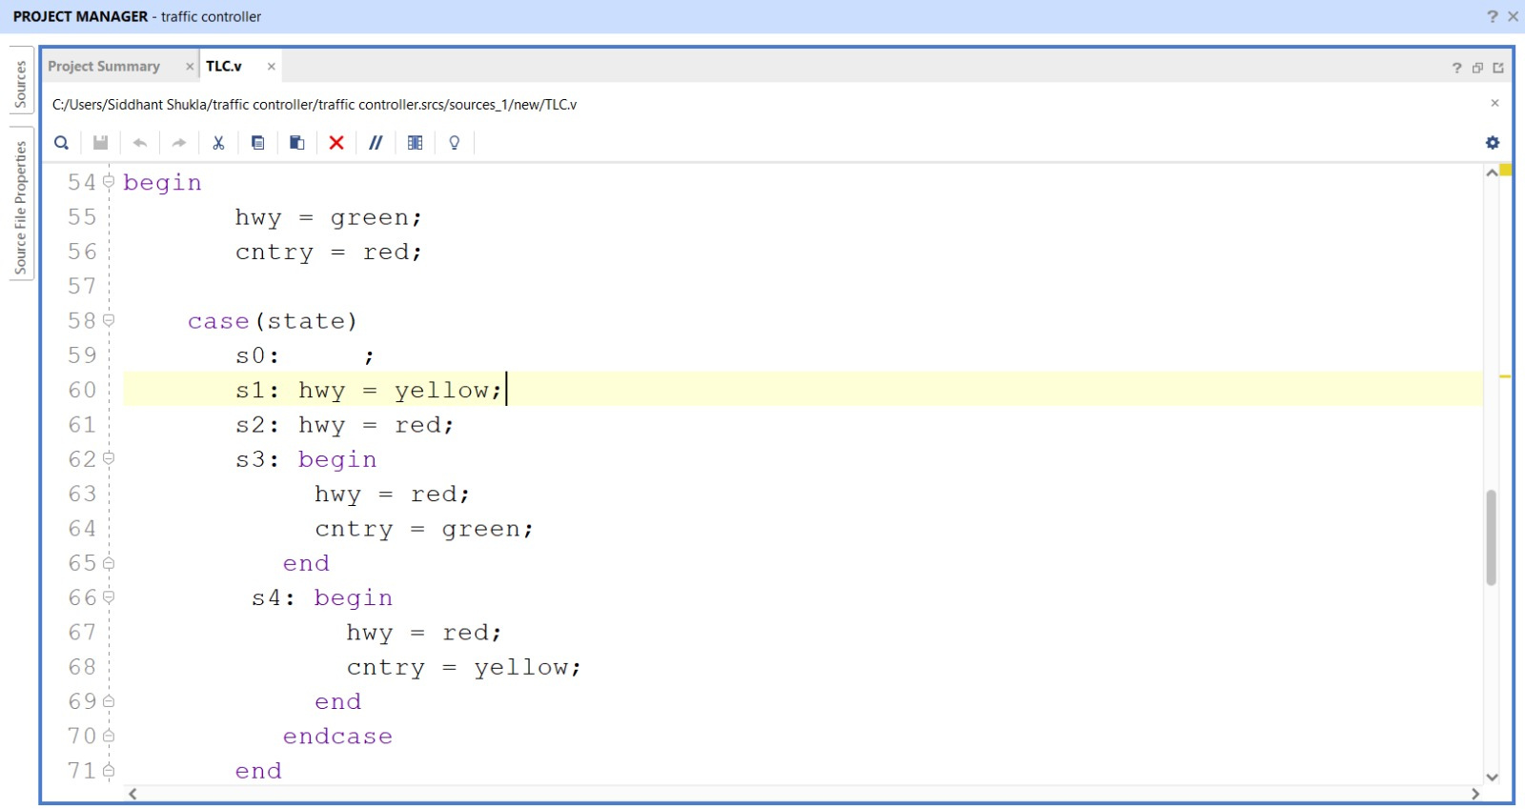

Slide 15
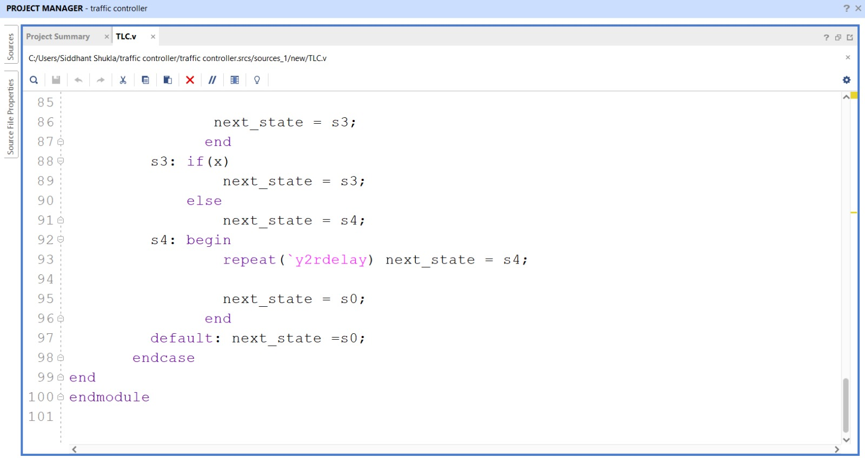

Slide 16
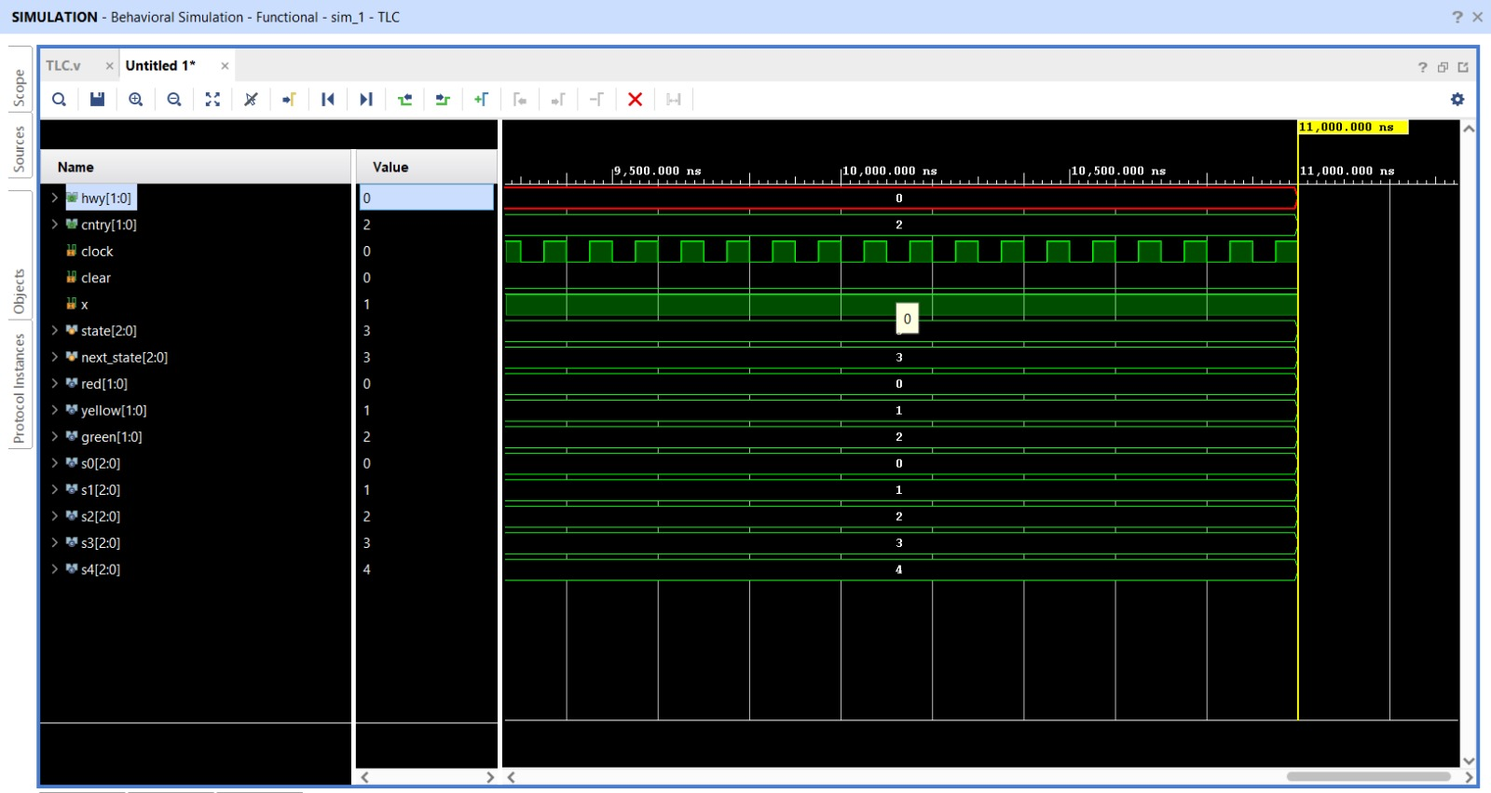
SIMULATION RESULT
CASE 1 : WHEN X = 0 ( no car present in the country side)

Slide 17
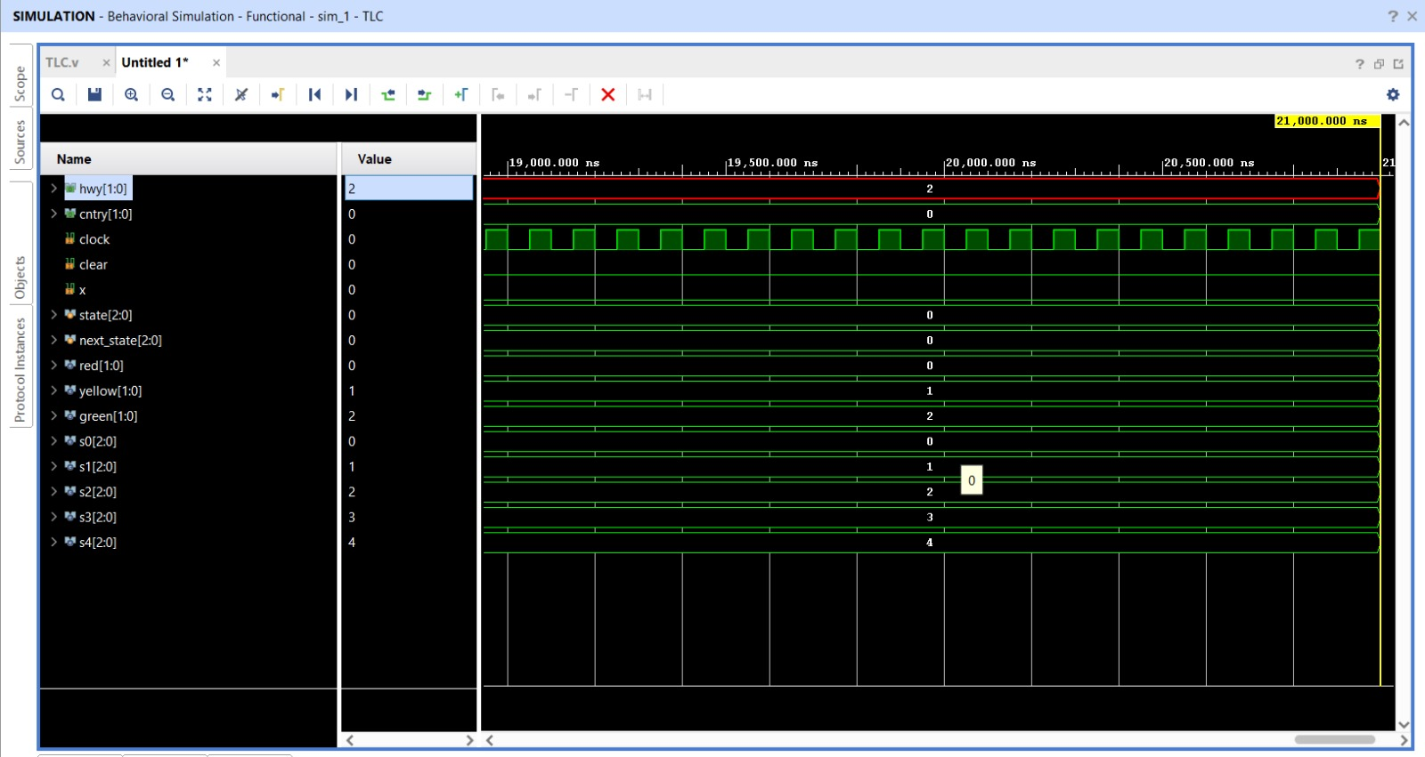
CASE 2 : X=1 , When vehicle present in the country side

Slide 18
CONCLUSION
The modern ways of multi - way traffic management improves the traffic condition up to a large extent advance signaling controllers contribute to improvement of the urban traffic which is proportional the complexity of the controller this more complex controller can be well handled using state machines .methods to reduce the states in the state machine also help in reducing the require hardware leading to low power and are efficient design .

Slide 19
THANK YOU

